Slide 1


Lecture2: Section 1.4
Nahid Majd, CSUSM
Computer Networking: A Top Down Approach
6th edition
Jim Kurose, Keith Ross
Addison-Wesley
March 2012
Performance measures: Delay, Loss, Throughput
Introduction
1-<number>

Slide 2
Chapter 1: introduction
our goal:
get “feel” and terminology
more depth, detail later in course
approach:
  use Internet as example
overview:
what’s the Internet?
what’s a protocol?
network edge; hosts, access net, physical media
network core: packet/circuit switching, Internet structure
performance: loss, delay, throughput
protocol layers, service models
Introduction
1-<number>

Slide 3
Chapter 1: roadmap
  1.1 what is the Internet?
  1.2 network edge
    end systems, access networks, links
  1.3 network core
    packet switching, circuit switching, network structure
  1.4 delay, loss, throughput in networks
  1.5 protocol layers, service models
  1.6 networks under attack: security
  1.7 history
Introduction
1-<number>

Slide 4


Transmission delay
Transmission delay: time required to load the pkts into the link
Source host:
takes application message
breaks into smaller chunks, known as packets, of length L bits
transmits packet into access network at transmission rate R
  link transmission rate, aka link capacity, aka link bandwidth (test your LAN BW with speedtest.net or OpenSignal App)
two packets,
L bits each
2
1
R: link transmission rate
host
packet
transmission
delay
time needed to
load L-bit
packet into link
L (bits)
R (bits/sec)
=
=
1-<number>

Slide 5
Transmission delay
How much time required to load a pkt into the link in each of following cases?
L (Pkt size) = 1Mb, R (Link BW) = 1Mbps
L (Pkt size) = 1Kb, R (Link BW) = 1Mbps
L (Pkt size) = 1Kb, R (Link BW) = 1Gbps
L (Pkt size) = 1Kb, R (Link BW) = 100Mbps
Transmission time
L (bits)
R (bits/sec)
=
1-<number>

Slide 6
Metric System
Abbr. | Prefix name | Decimal size | Size in thousands | Binary approximation
G | Giga- | 10⁹ | 1000³ | 1024³ = 2³⁰
M | Mega- | 10⁶ | 1000² | 1024² = 2²⁰
K | Kilo- | 10³ | 1000¹ | 1024¹ = 2¹⁰
m | Mili- | 10⁻³ | 1000⁻¹ | 1024⁻¹ = 2⁻¹⁰
μ | Micro- | 10⁻⁶ | 1000⁻² | 1024⁻² = 2⁻²⁰
n | Nano- | 10⁻⁹ | 1000⁻³ | 1024⁻³ = 2⁻³⁰
https://en.wikipedia.org/wiki/Micro-
1-<number>

Slide 7






Packet-switching: store-and-forward
L bits
per packet
source
3
2
1
R bps
R bps
destination
takes L/R seconds to transmit (load) one L-bit pkt into link at R bps
store and forward: entire packet must arrive at router before it can be transmitted on next link
In this picture: end-end delay for one packet = 2L/R
  (one L/R for each link)
Numerical example: L=7.5 Mb, R=1.5 Mbps
end-end delay for one packet =2*5=10 (5 sec for each link)
Important note: This formula works only when other delays are zero.
Introduction
1-<number>

Slide 8
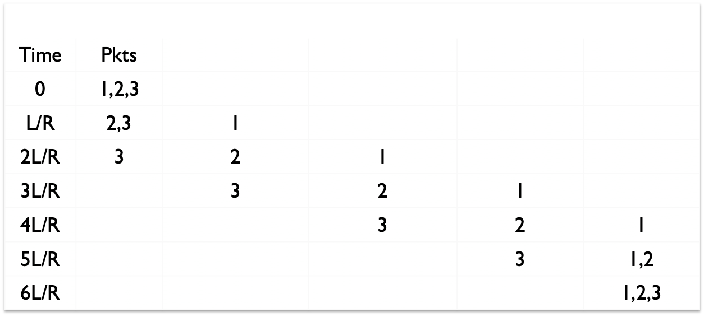
Transmission delay
Q: end-to-end delay for 4 links and 3 packets?
6 L/R
source
destination
R bps
R bps
R bps
R bps
Important note: This calculation works only when other delays are zero.
Introduction
1-<number>

Slide 9
End-to-end delay for consecutive packets
Q: end-to-end delay for N links and P packets?
(N+P-1)L/R
source
destination
…
R bps
R bps
R bps
R bps
R bps
It takes L/R sec to transmit (load) one L-bit pkt into link at R bps
End-end delay of each packet = N* L/R (one L/R for each link)
End-end delay of a message containing P packets =
waiting time of P^{th} pkt at source (for earlier pkts to be transmitted)+end-end delay of P^{th} pkt
= (P-1)* L/R + N*L/R = (N+P-1)*L/R
Important note: this formula is applicable for a very simple case where only the transmission delay is considered. If other types of delays like propagation delay also needs to be considered, this formula does not work. For such cases refer to slide 15.
Introduction
1-<number>

Slide 10
Packet Switching: queueing delay, loss
R = 100 Mb/s
C
A
D
R = 1.5 Mb/s
B
E
queue of packets
waiting for output link
queuing and loss:
If arrival rate (in bits) to router exceeds transmission rate of outgoing link for a period of time:
  packets will queue, wait to be transmitted on link
  packets can be dropped (lost) if memory (buffer) fills up
  queuing delay is variable and depends on the congestion
Introduction
1-<number>

Slide 11
How do loss and delay occur?
packets queue in router buffers
Packet rate transmitted to output link (temporarily) exceeds link capacity
packets queue, wait for turn
packet being transmitted (delay)
A
B
packets queueing (delay)
free (available) buffers: arriving packets
dropped (loss) if no free buffers
Introduction
1-<number>

Slide 12
Packet loss
queue (aka buffer) preceding link in buffer has finite capacity
packet arriving to full queue dropped (aka lost)
lost packet may be retransmitted by previous node, by source, or not at all
buffer
(waiting area)
A
packet being transmitted
B
packet arriving to
full buffer is lost
Refer to the Video Queue_Loss on Cougar Courses.
Introduction
1-<number>

Slide 13
Four sources of packet delay
transmission
A
propagation
B
nodal
processing
queueing
d_{nodal} = d_{proc} + d_{queue} + d_{trans} + d_{prop}
d_{proc}: nodal processing
check bit errors
determine output link
typically < microsecs
d_{queue}: queueing delay
time waiting at output link to reach the head of queue
depends on congestion level of router
Introduction
1-<number>

Slide 14
Four sources of packet delay
transmission
A
propagation
B
nodal
processing
queueing
d_{nodal} = d_{proc} + d_{queue} + d_{trans} + d_{prop}
d_{trans}: transmission delay:
L: packet length (bits)
R: link bandwidth (bps)
d_{trans} = L/R
d_{prop}: propagation delay:
d: length of physical link
s: propagation speed in medium ~2x10⁸ m/sec (meters per sec)
d_{prop} = d/s
d_{trans} and d_{prop}
very different
Introduction
1-<number>

Slide 15
End-to-end delay for consecutive packets
A
B
L= 500 Byte (pkt length) At each link:
At each hop: R=1Gbps
d-proc = 1 μsec d= 0.5 Kmeters
d-que = 2 μsec s= 1 G meters/sec
(Gigameters per sec)
End-to-end delay for a message of 1 pkt?
End-to-end delay for a message of 4 pkts?
End-end delay for one pkt = ??? μsec
End-end delay for the whole msg (containing 4 pkts) = ??? μsec
  (When does the 4th pkt arrive at destination?)
Introduction
1-<number>

Slide 16
Throughput
Throughput: rate (bits/time unit) at which bits are arriving at the destination
  instantaneous: rate at any given point in time (instant of time)
  Average throughput: rate over longer period of time
  While a file is downloading, the app displays the throughput
server, with
file of F bits
to send to client
link capacity
R_{s} bits/sec
link capacity
R_{c} bits/sec
server sends bits
(fluid) into pipe
pipe that can carry
fluid at rate
R_{s} bits/sec)
pipe that can carry
fluid at rate
R_{c} bits/sec)
Rs: Server can pump bits through its link at most at rate Rs
Rc: Router can pump bits through its link at most at rate Rc
Introduction
1-<number>

Slide 17
Water pipes example
1 units/sec
1)
5 units/sec
How much
output?
5 units/sec
2)
1 units/sec
How much
output?
Introduction
1-<number>

Slide 18
Throughput (more)
R_{s} < R_{c} What is average end-end throughput?
R_{s} bits/sec
R_{c} bits/sec
R_{s} > R_{c} What is average end-end throughput?
R_{s} bits/sec
R_{c} bits/sec
bottleneck link
link on end-end path that constrains end-end throughput.
End-end throughput = min {Rs, Rc}
Introduction
1-<number>

Slide 19
Throughput: Internet scenario
…
More than one traffic pass through a link
per-connection end-end throughput: min(R_{c},R_{s},R/10)
in practice: R_{c} or R_{s} is often bottleneck
Links are shared among several src-dst connections
R_{s}
R_{s}
R_{s}
R
R_{c}
R_{c}
R_{c}
…
10 connections (fairly) share backbone bottleneck link R bits/sec
Introduction
1-<number>

Slide 20
Throughput and delay
How much delay and throughput is required? It depends on the application.
  VOIP: low delay, a throughput above some threshold
  File transfer application: delay is not critical, highest possible throughput is desirable
Introduction
1-<number>

Slide 21
Jitter
What is jitter?
The difference of two numbers (B-A):
The amount of time between the transmission of two successive packets at the sender
The amount of time between the receipt of those two packets at the destination
Q: What is the best jitter?
Q: What could be the reason of a high jitter?
A: B:
source
destination
Time between
transmission
of two pkts
Time between
reception
of two pkts
Network Layer
4-<number>

Slide 22
Jitter: positive or negative?
at source
at destination
A: B:
Jitter=?
0
2
10
16
Jitter=?
0
6
10
12
Jitter=?
0
2
10
12
Jitter=?
0
2
10
16
Jitter=?
0
6
10
12
Jitter=?
0
2
10
12
Network Layer
4-<number>

Slide 23
Network service model
Q: What services can be provided by the network layer?
How to verify the quality of services provided by the network layer?
1. services for individual packets:
Reliability: guaranteed delivery
guaranteed delivery with a bounded end-to-end delay
2. services for a flow of packets:
in-order datagram delivery
guaranteed high bandwidth to flow
guaranteed low jitter: restrictions on changes in inter-packet spacing
security
Network Layer
4-<number>

